Slide 1
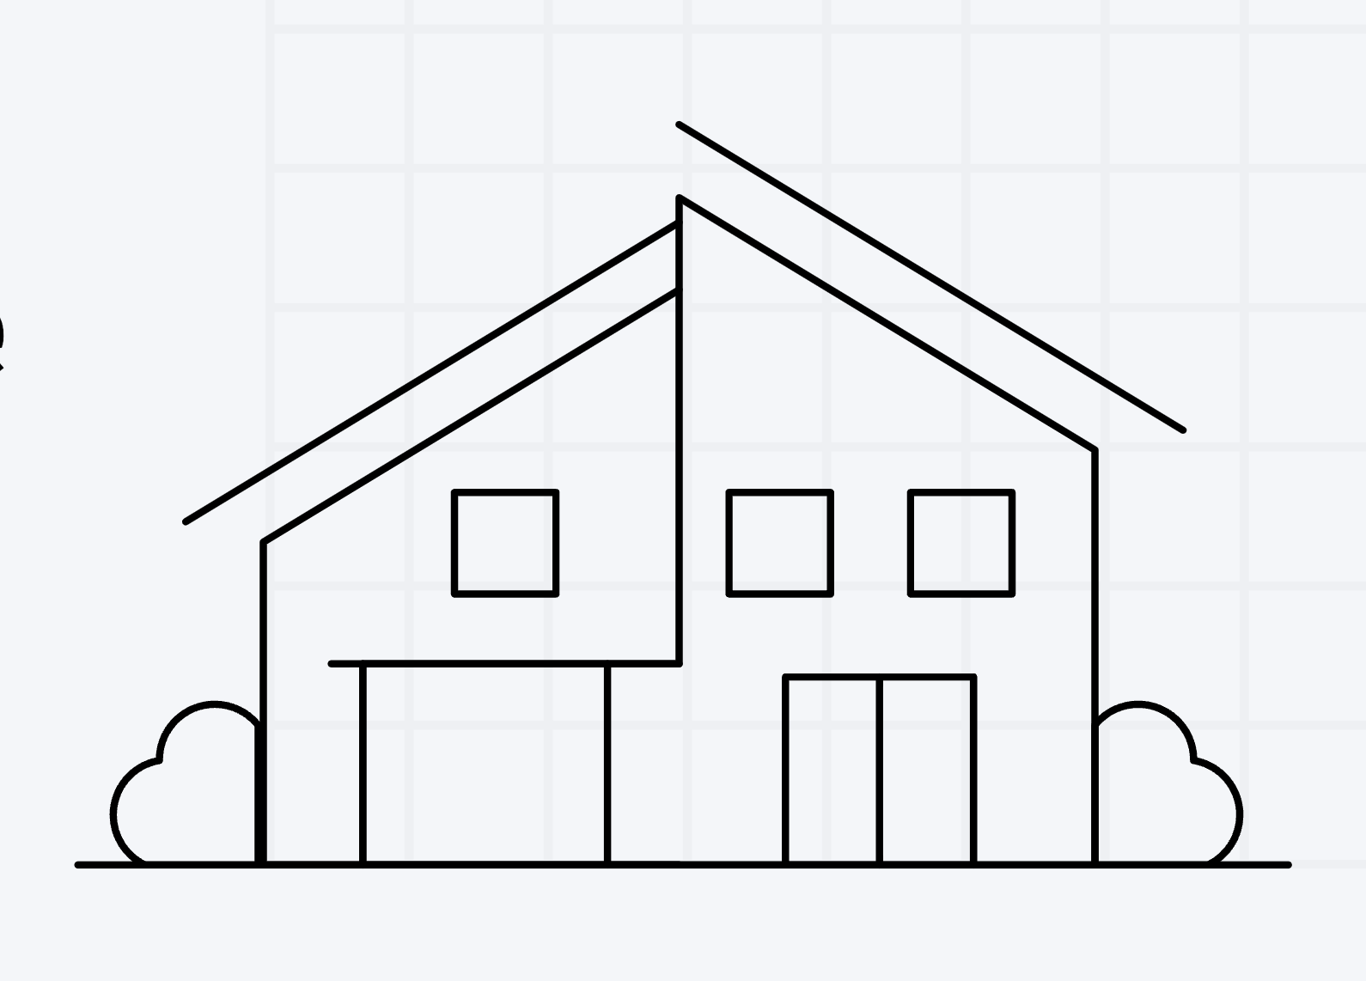
Bangkok Housing Prices
Team Éclair
Notes:
Good afternoon,We are team Éclair. Today we, as a property consultant company based in Bangkok, would like to present our key insights on current Housing Prices in the Bangkok and selected surrounding areas.

Slide 2

Problem statement
Which important factors and market conditions have the greatest impact on residential property selling prices across Bangkok's districts during 2023-2024, focusing on condominiums, townhouses, and single-family homes?
Notes:
Our problem statement is: "Which important factors and market conditions have the greatest impact on residential property selling prices across Bangkok's districts in 2023-2024, focusing on condominiums, townhouses, and single-family homes"

Slide 3
What to look for?
The best investment for the future and value for money.
Give recommendations for new home buyers.
Notes:
We will direct you to the most important factors for real-estate investing. What should you prioritize to get the best value for money as well as thinking of the future? There are many elements that contribute to a wise investment decisions. OUr goal is to provide a recommendation to do so for new and seasoned homebuyers such as yourselves.

Slide 4
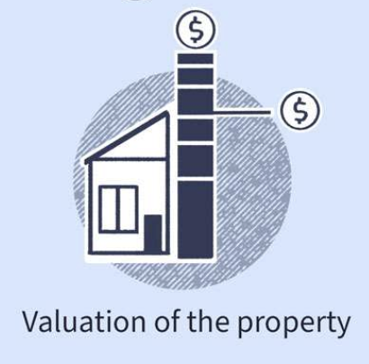
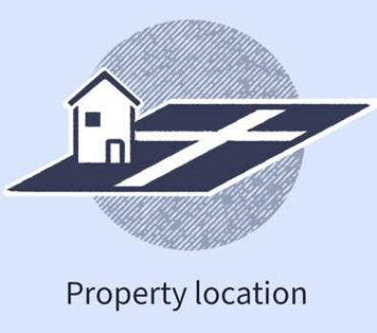
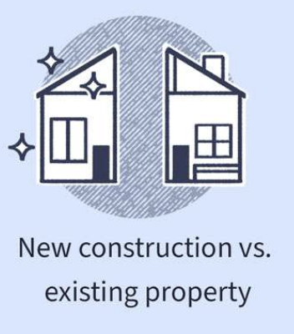
Factors influencing prices
Notes:
Different buyers will always prefer different factors. However, the most attractive features would help sell the property as these would have a good correlation to the house’s price, hence these strong indicators of house prices should be considered during your decision-making.
Features are simply the physical characteristics of the property, such as...1. location requirements (which province? which district?), 3. about the property itself such as the type of property from condominiums, detached houses, and townhouses, age... 3. If choosing a high-rise building such as a condominiums, which floors provide the best pricings? Remember, the number one factor is off course, PRICE of the property.
Province: Bangkok, Nonthaburi, Samut Prakarn Districe
Property Type : Condo, Detached House, Townhouse
Nearby Mass Public Transportation : Is it nearby a BTS (), MRT (), or any other public transport such as the ARL (Airport Rail Link) ?
Floor Level : Low < 8 floors, medium < 100 units, high > 100 units
Facilities : The more the better? Swimming pools, sauna, spas?
Carparks : Is there a car park available? Yes / No
Number of nearby : buses, shops, supermarkets

Slide 5
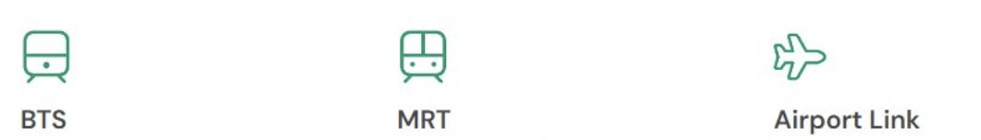
Driving factors transportation
Bangkok Transit System Skytrain
Metropolitan Rapid Transit
Airport Rail Link
Notes:
Another important driving factor for property prices in Bangkok is "Public transportation". Traffic is a well-known problem for Bangkok, and thus, demand forplaces with close proximity to popular transportation modes such as the "BTS, MRT, and the airport link, which connects downtown Bangkok with the airport.

Slide 6

Living space
Notes:
Back to the purpose of purchase: Do you need a large space? What sort of activities are important to your daily life? In that case, next to price, type, and location, we should also consider....
Number of Beds
Number of Baths
Meters Squared Area (m2)

Slide 7
Influence of property type
Detached house: More expensive than the Condo
Townhouse : are less expensive than the condo
Notes:
Let's continue to look at property types and their influences on price. On average, detached houses are more expensive compared to condominiums. On the other hand, townhouses are much more affordable than condominiums. (A coefficient of 437,530 Bath price suggests that detached houses are generally more expensive
A coefficient of −978,815.4 Bath price indicates that townhouses, on average, are less expensive )
The majority of condominium developers in the central business district and along mass transit lines is high rise the information from krungsri bank

Slide 8
Influence of buildings classified
Low
rise
Medium
rise
High
rise
Notes:
Floor level or building classified is an important factor affecting housing price and is also a key to understand the amenity value of landscapes from vertical dimension
Low rise is lowest price when compare with other classified
Medium rise price is between low and high
High rise is more expensive than low and slightly pricier than meduim

Slide 9
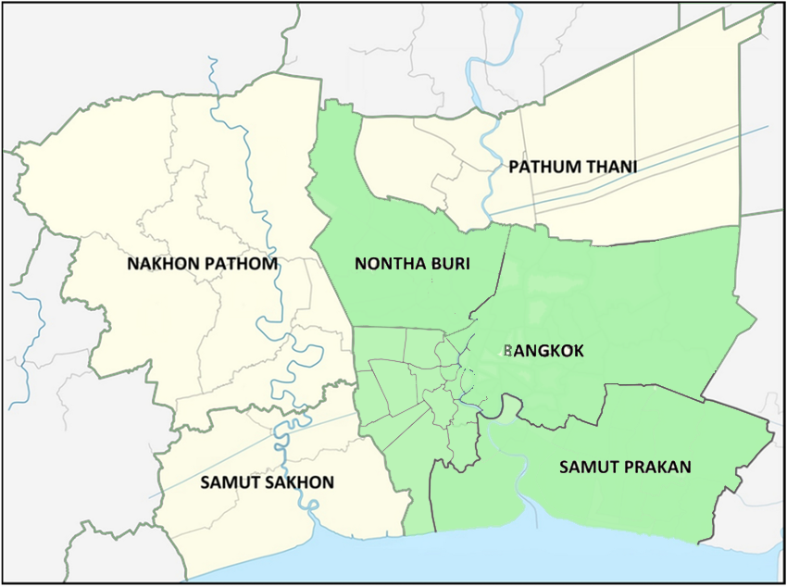
Comparing provinces
Nonthaburi are 1,103,291 Baht priced lower compared to Bangkok
Samut Prakan are 1,328,945 Baht priced lower compared to Bangkok
3 Provinces Number of properties
Bangkok 9130
Nonthaburi 2970
Samut Prakan 2171
Source: Bangkok Metropolitan Region: Bangkok and Five Surrounding Provinces
Notes:
Our dataset contains housing information for Bangkok, Nonthaburi, and Samut Prakarn. The majority is located in Bangkok. Typically, both Samut Prakarn and Nonthaburi fare lower than Bangkok in terms of pricing, by a staggering 1.3 and 1.1 million Baht respectively.( If comparing similar properties)

Slide 10
Neighborhoods and pricing trends
Prime Areas
Pathum wan
Bang rak
Watthana
Sathon
Khlong toei
Areas to Avoid
Nong chok
Thung khru
Bang bon
Nong khaem
Khlong sam wa
Notes:
Compared to other districts, Pathum wan is valued the highest at 2.6 million Baht (2.633349e+06) Other top 4 districts are Bang rak, Watthana, Sathorn, and Khlong Toei, which is no surprise as these are important central business districts with multinational offices and high-end malls. On the other hand, further out districts tend to hold less value, the lowest being Nong chok at 3.1 million.-3.142013e+06

Slide 11
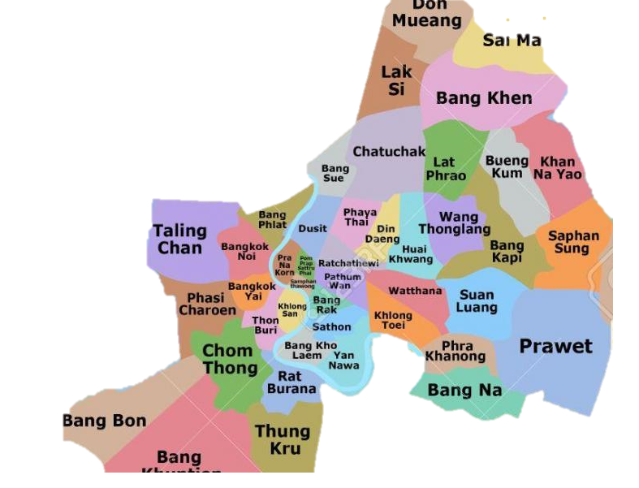
Prime Areas
Source: https://maps-bangkok.com/bangkok-district-map

Slide 12
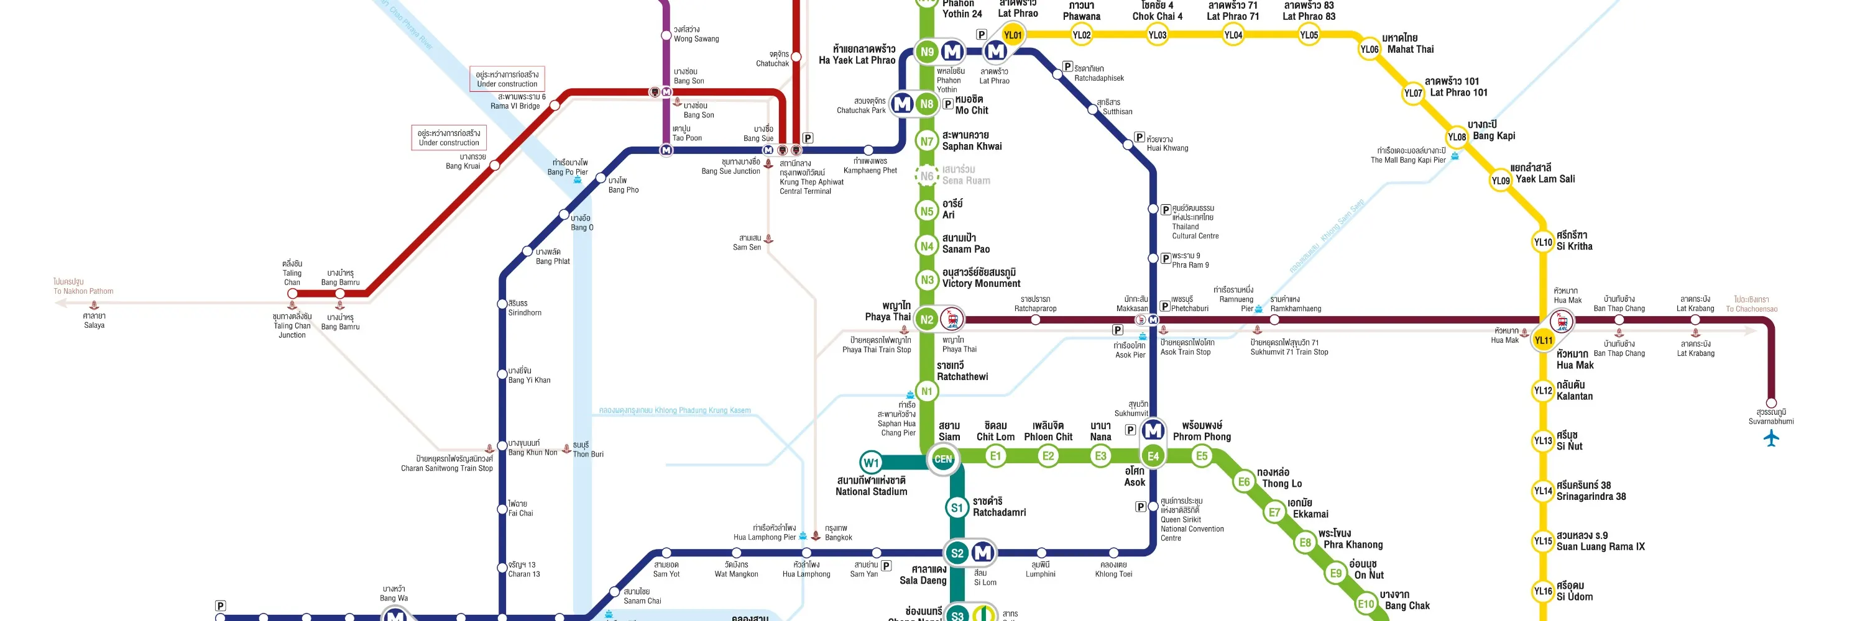
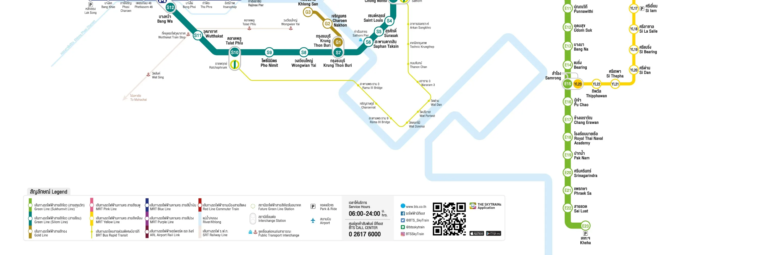

Top 15 BTS stations
E9 On nut BTS (Khlong toei)
E4 Asok BTS (Khlong toei)
E6 Thong lo BTS (Wattana)
E8 Phra khanong BTS (Khlong toei)
E12 Udom suk BTS
E5 Phrom phong BTS (Wattana)
E7 Ekkamai BTS (Wattana)
E11 Punnawithi BTS
E14 Bearing BTS
N7 Saphan kwai BTS
N6 Sena ruam BTS
N2 Phaya thai BTS
E15 Samrong BTS
E10 Bang chak BTS
Source: https://www.klook.com/activity/11626-bts-skytrain-rabbit-card-bangkok/
Notes:
Patumwan (BTS siam ,Chidlom ,Ratchadamri ,PhloenChit National Stadium (siam paragon)
Bangrak (BTS Chong Nonsi, Sanit Louse Surasak saladaeng) office area
Sathon(S5 Surasak)
Wattana (BTS Thong Lo, Ekkamai , NANA)
Khlong toei (BTS Phrom Phong , ASOK, Phrakhanong , BTS Onnut)

Slide 13
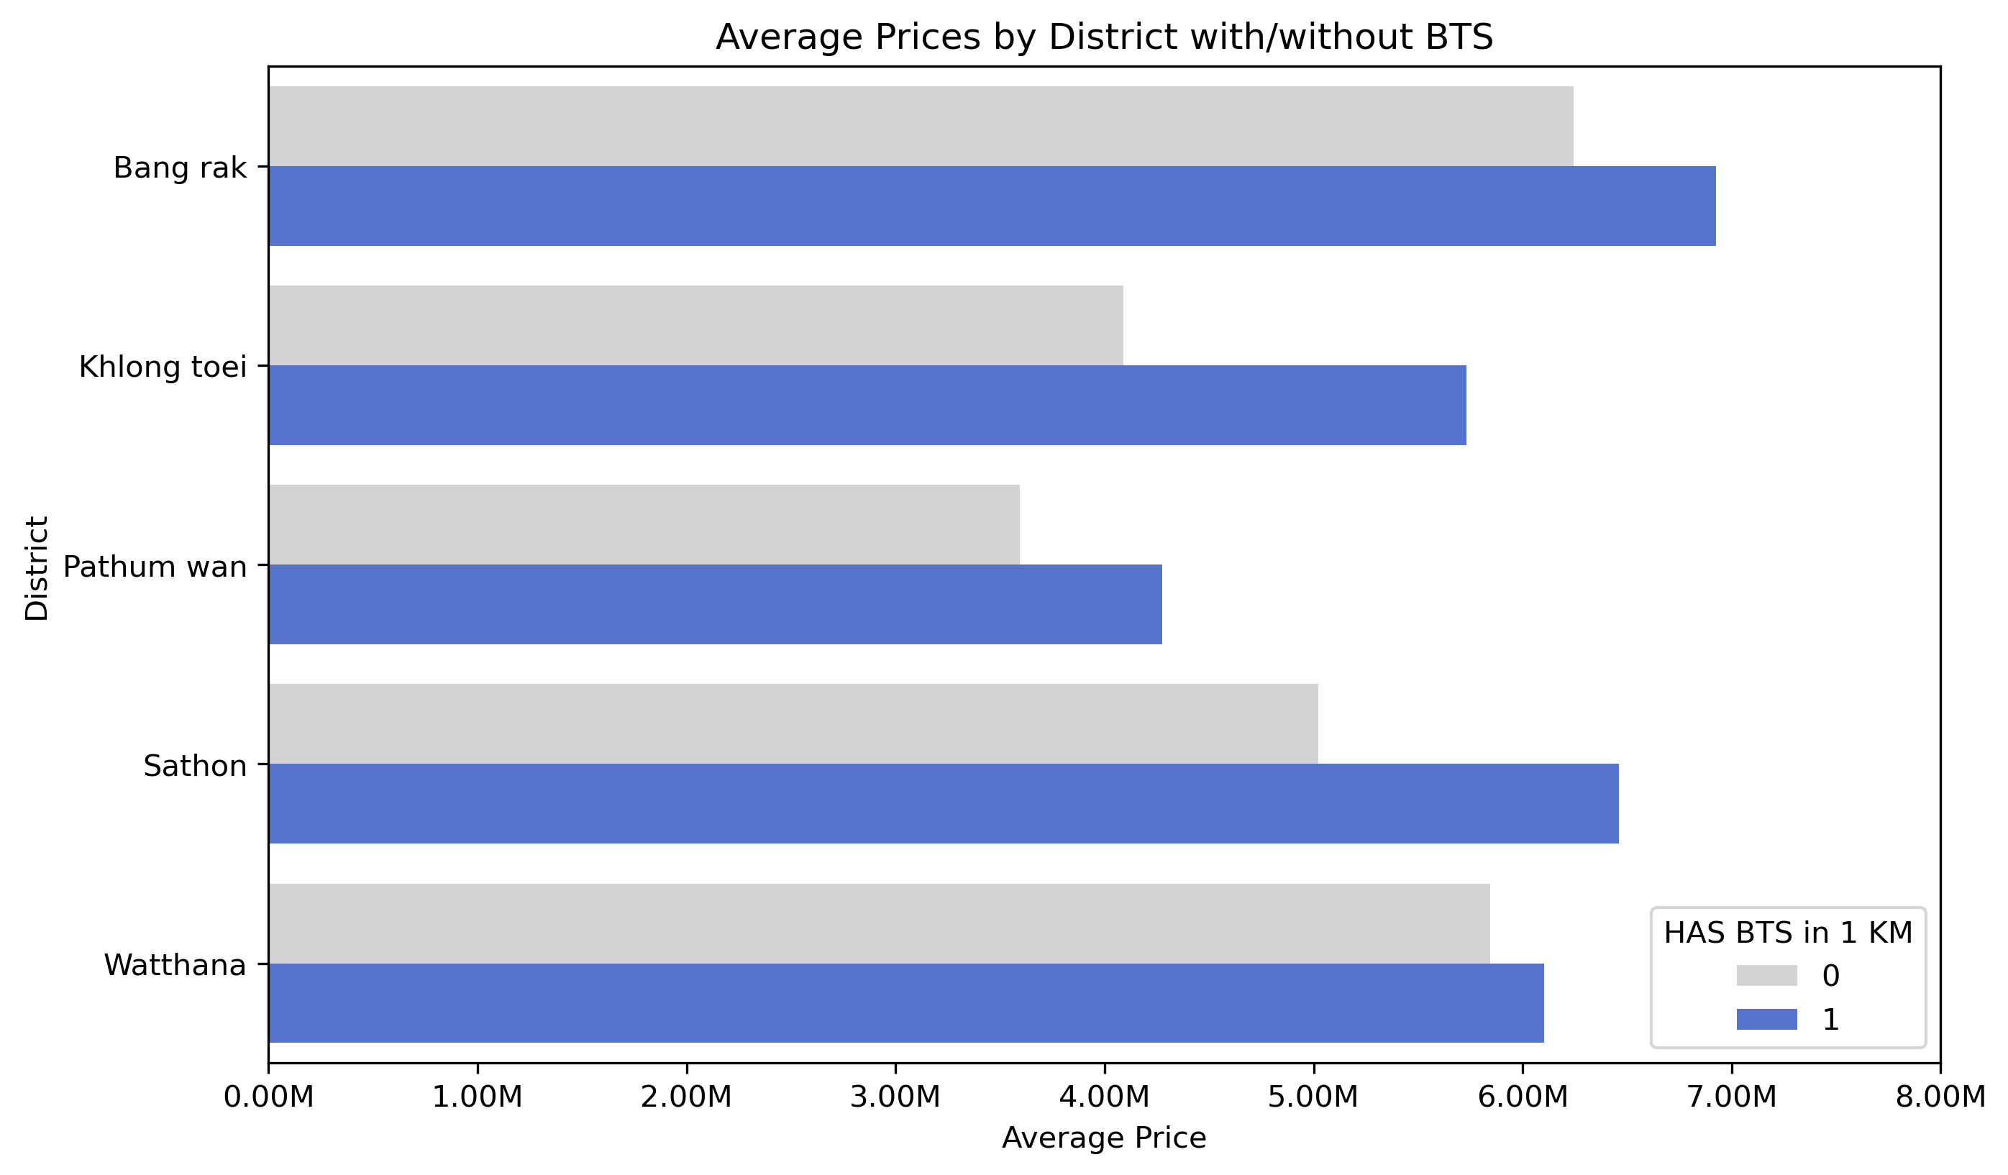
Has BTS
Notes:
https://www.area.co.th/t/67#:~:text=%E0%B8%9C%E0%B8%A5%E0%B8%81%E0%B8%B2%E0%B8%A3%E0%B8%A8%E0%B8%B6%E0%B8%81%E0%B8%A9%E0%B8%B2%E0%B8%9E%E0%B8%9A%E0%B8%A7%E0%B9%88%E0%B8%B2,%E0%B9%81%E0%B8%95%E0%B8%81%E0%B8%95%E0%B9%88%E0%B8%B2%E0%B8%87%E0%B8%81%E0%B8%B1%E0%B8%99%E0%B8%97%E0%B8%B5%E0%B9%88%2088%25
1999-2009 (B.E. 2542-2552) land prices near the BTS increased by 239% of the competitive area again by only 151%, resulting in a difference of... 88%.

Slide 14
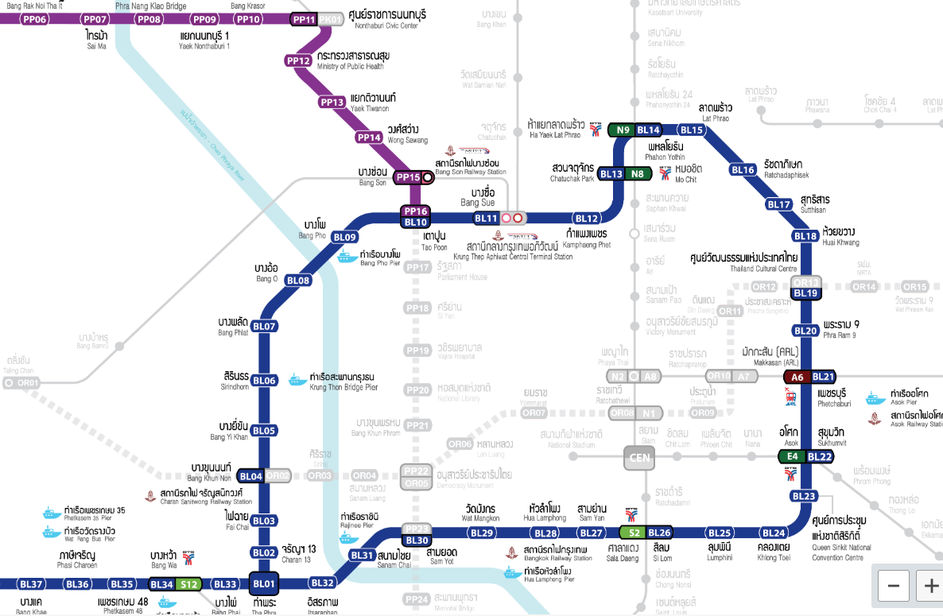




Top 15 MRT stations
BL20 Phra ram 9 MRT (Huai khwang)
BL18 Huai khwang MRT (Huai khwang)
BL21 Phetchaburi MRT (Huai khwang)
PP09 Yaek nonthaburi 1 MRT
BL15 Lat phrao MRT
PP10 Bang krasor MRT
BL16 Ratchadaphisek MRT (Huai khwang)
BL14 Phahon yothin MRT
BL12 Kamphaeng phet MRT
BL22 Sukhumvit MRT
PP12 Ministry of public health MRT
PP13 Yaek tiwanon MRT
PP11 Nonthaburi civic center MRT
BL17 Sutthisan MRT (Huai khwang)
Source: https://metro.bemplc.co.th/MRT-System-Map?lang=en
Notes:
Go to the public transportation

Slide 15
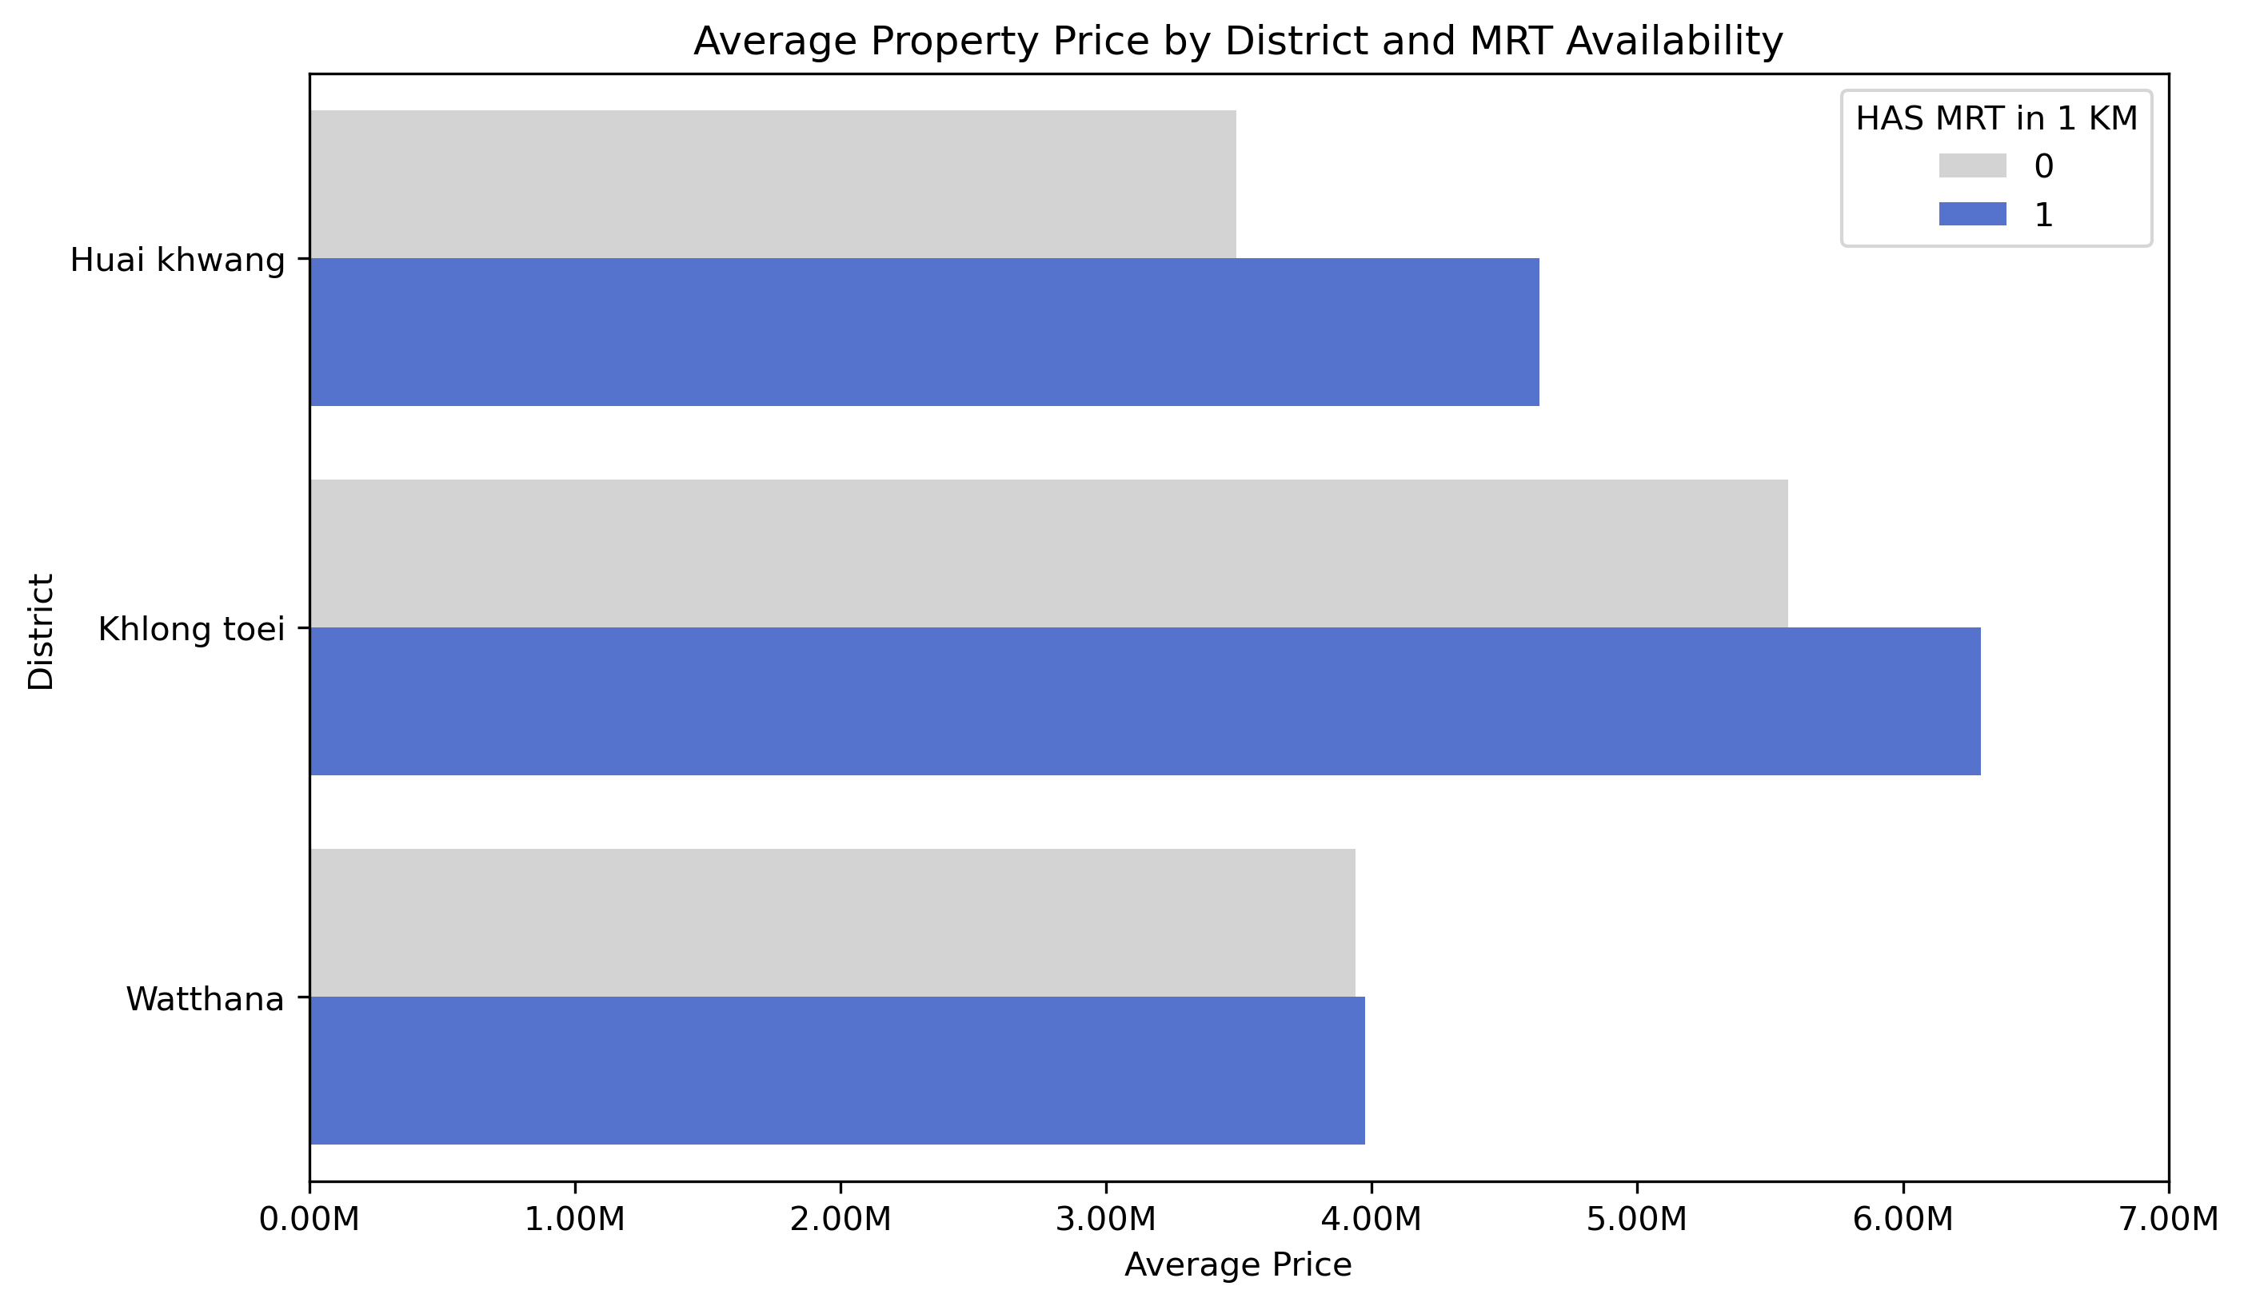
Has MRT
Notes:
Khlong Toei - MRT Khlong Toei
Wattana – MRT Sukhumvit
Phaya Thai –

Slide 16
Recommendations
Homebuyers and investors should invest in properties that have:
1. A good, central location in Bangkok's prime areas (Pathumwan, Bangrak, Wattana, Sathorn.)
2. Close proximity to public transportation, located in prime areas, preferably along the BTS Sukhumvit Line
3. Carefully consider your space requirements.
Notes:
Central location (e.g. Pathumwan), Sukumvit Line (e.g. Onnut, PhromProng). Larger spaces cost more in Bangkok, family sized homes reach up to 10 million. There are the pricing trends that will continue with the city of Bangkok's economic growth, demand for space, and population. Other factors can influence housing prices as well, especially other transportation methods such as the MRT and the airport rail link. However, these facilities are also relatively located in prime areas. All in all, all these factors have one thing in common …"Prime Areas". Intuitively shopping centers, bust stops, groceries... offices, even the best schools, would be located in 'Prime areas". Thus, the old saying still holds true to today "Location, location, location".

Slide 17
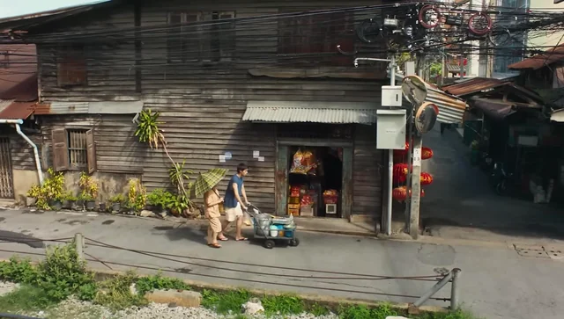
Source: GV Pictures How to Make Millions Before Grandma Dies
Notes:
Don’t wait to buy real estate buy real estate and wait

Slide 18
Thank you for your attention. Questions?

Slide 19
Price Range
Lower End
Starting at 480,000 Baht, this range includes smaller square area , older properties and further location
Luxury
Reaching 9.9 Million Baht and beyond, this category includes detached house , exclusive facilities

Slide 20
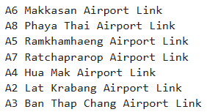
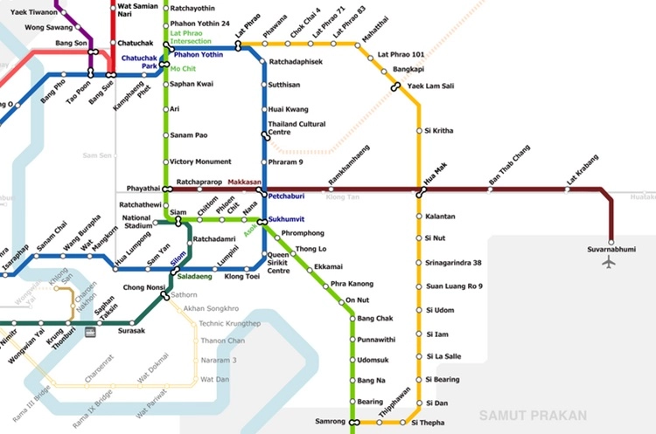

Top Airport Link Stations
Source: Airport Rail Link Bangkok - Ticket price, route & time table
Notes:
Go to the public transportation

